Slide 1
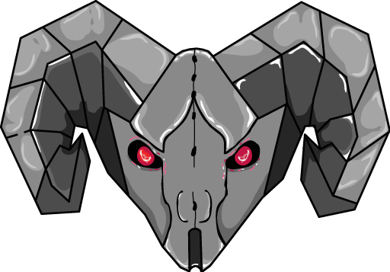
Team 999
MechaRAMS
Vision for the Build & Electrical Teams
What the vision system needs from the robot — and what the tests will tell us to change
Follow-up to “Robot Localization & Precision Driving” — assumes you've seen the algorithms deck
For students and mentors · Summer 2026

Slide 2
Why vision precision starts with you
Team 999
MechaRAMS
THE ONE NUMBER TO REMEMBER
A 1° camera-mount error ≈ 5+ cm of position error at 3 m.
That is the same size as the entire precision budget of our best driving algorithm (~3 cm). No software recovers what a loose bracket throws away.
Cameras are precision optical instruments bolted to a machine that rams things. Their mounts, wiring, and power are build/electrical deliverables.
In 2026, our aiming was off by 2–3° with no way to tell why. Part of the fix is software — the other part is mounts we can trust and measurements we can repeat.
This deck: what to build, what to measure, how testing will feed you decisions (and work), and what other teams need from you.
2

Slide 3
The hardware set (pilot configuration)
Team 999
MechaRAMS
Item | Spec | Notes
2× Arducam OV9782 | global-shutter COLOR, 1280×800, USB2, M12 low-distortion lens | global shutter is non-negotiable for a moving robot
1× Orange Pi 5 | runs PhotonVision; 2 camera streams | proven safe budget = 2 tag cameras per Pi; scale-up = a second Pi, not more load
Tag board | 2 printed AprilTags (IDs 1 & 2), 6.5 in / 0.1651 m | our indoor “field” — flatness and placement accuracy matter
2025 chassis | SDS MK4 L3, CANivore, Pigeon 2 (ID 40) | testbed; 2026 robot stays intact as baseline
Growth path | +2 cameras (back-left/back-right) + 2nd Pi | only if test data proves rear coverage is needed — brackets worth planning for
3

Slide 4
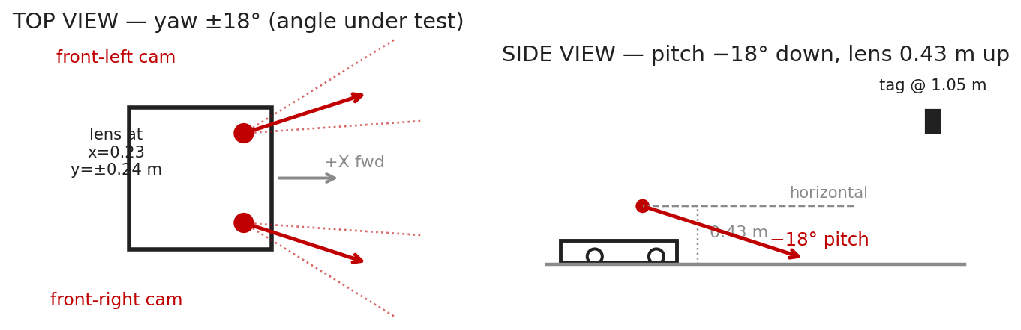
Camera placement — the current (provisional) geometry
Team 999
MechaRAMS
Front corners, lens at (x 0.23, y ±0.24, z 0.43 m) from robot center-floor; pitched 18° DOWN, yawed ±18° — the cross-eye angle whose exact value (and direction) the coverage tests will confirm or change.
These numbers are PROVISIONAL — an engineering guess the tests will confirm or change. Build the mounts so the angle could be adjusted once, then locked and measured.
4

Slide 5
Mount requirements — rigid, protected, repeatable
Team 999
MechaRAMS
RIGID
PROTECTED
REPEATABLE
No flex under acceleration or impact. A mount that moves 1° under load adds an error software cannot see directly — it just makes one camera mysteriously “fuzzier.” Metal brackets or thick printed parts with short load paths; no long cantilevers.
Lenses live inside the frame perimeter or behind polycarb. A scratched or bumped lens = recalibration at best. Nothing may press on the lens barrel — focus shifts void the calibration.
If a camera is removed and remounted, it must return to the SAME position (locating pins / machined seats beat slotted holes). Every remount without repeatability = full re-measurement + recalibration.
AFTER ANY MOUNT CHANGE
Tell programming immediately. The robot-to-camera transform in code and in PhotonVision must be re-measured (position to ~5 mm, angles to ~0.5°). Silent changes poison every measurement that follows.
5

Slide 6
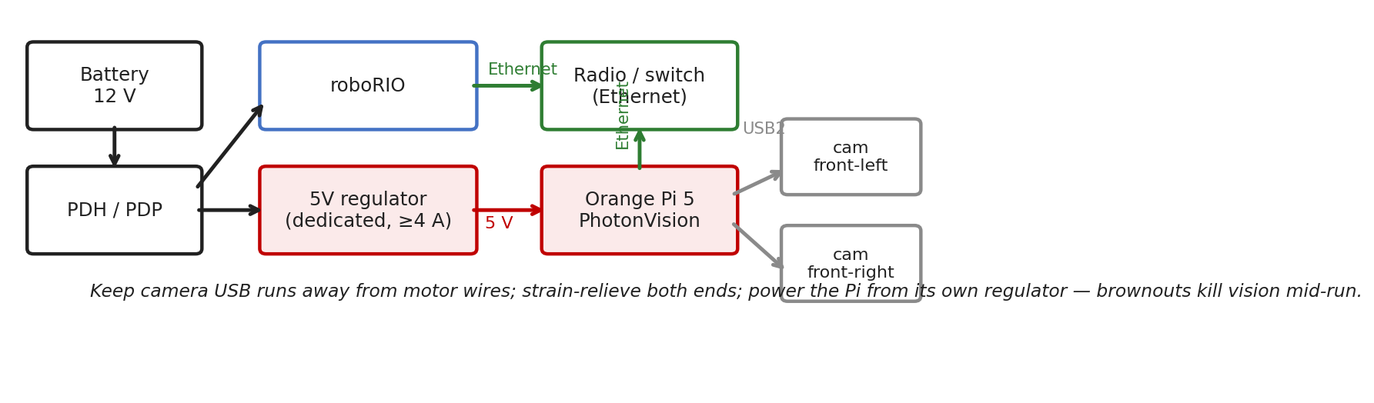
Electrical — power, wiring, network
Team 999
MechaRAMS
The Orange Pi gets its OWN 5 V regulator (≥4 A): a brownout reboots PhotonVision — ~30 s of blindness. Never share its supply with motors or the radio.
USB runs: shortest practical, away from motor power, strain-relieved at BOTH ends; Ethernet Pi → radio/switch. Label everything — “front-left” must mean the same camera every time.
6

Slide 7
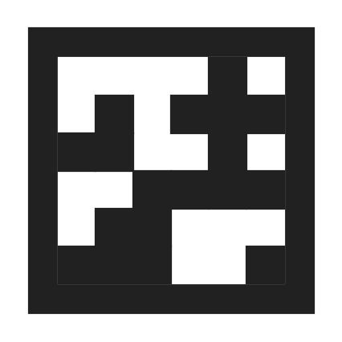
The tag board — our indoor field
Team 999
MechaRAMS
Two tags, IDs 1 & 2, printed at EXACT scale: 0.1651 m (6.5 in) black square. A 2% print-scale error = 2% range error everywhere, forever.
Mounted at tag centers (6.0, 1.75, 1.05) and (6.0, 2.25, 1.05) in field coordinates, facing the robot (−X). 0.5 m apart, 1.05 m high.
The board must be FLAT (no paper wrinkles — mount on rigid sheet), VERTICAL (check with a level), and repeatably placed — tape its floor position.
Matte finish; even lighting. Glare or shadow across a tag ruins frames — our color global-shutter cameras want light.
If the board moves or is rebuilt, its coordinates in code + PhotonVision must be updated — same rule as camera mounts: tell programming.
ID 1 ID 2
0.5 m center-to-center · centers 1.05 m above floor
7

Slide 8
Calibration — where build & electrical do the work
Team 999
MechaRAMS
Stage | What happens | Your part
2 — Intrinsics | each camera photographs a ChArUco target from many angles | print + mount the target on a RIGID flat board at exact scale; provide good even lighting
3 — Extrinsics | measure each lens position + angles from the robot origin | the measuring itself: (x,y,z) to ~5 mm, angles to ~0.5° — jigs/fixtures welcome; CAD values are the starting point
4 — Accuracy grid | robot placed at surveyed floor positions, pose error recorded | tape the survey grid accurately (positions to ~1 cm); repeatable robot placement fixtures help enormously
5 — SysId | drivetrain characterization runs | battery fresh + secured, wheels/treads consistent, robot safely supported where needed
Rule of thumb: the software measures to millimeters — so the physical setup has to be honest to millimeters first.
8

Slide 9
What the tests will tell YOU (data → build decisions)
Team 999
MechaRAMS
Cross-eye angle: keep ±18° or change it?
2 cameras or 4?
Is a mount flexing?
The curved-path runs produce a coverage map — when the robot turns, how often does each camera drop to 1 or 0 tags? Blind moments = a remount request with the new angle, from data, not debate.
If blind moments cluster when the robot rotates away from the board, the rear camera pair earns its brackets, wiring, and second Pi. The code is already wired for them — the decision is a build/electrical project trigger.
Each camera gets an error-vs-distance curve. A camera consistently fuzzier than its twin at the same distance = mount flex or bad calibration. Expect a “please stiffen this bracket” ticket with the plot attached.
Every one of these comes from the SAME logs the algorithm tests produce — no extra test days, but real build work may come out of them.
9

Slide 10
Simulation — you're in it even without hardware
Team 999
MechaRAMS
The simulator runs the REAL vision pipeline with a modeled OV9782 (resolution, field of view, frame rate, latency, pixel noise) — and it places the simulated cameras using YOUR measured mount transforms.
So: mount measurements land in code → the sim immediately reflects the new geometry → coverage predictions update BEFORE anything is re-machined. Bad angle ideas die in sim, cheaply.
The tag board in sim is the same layout file as the physical board — if the physical board is built to spec, sim results transfer.
Practical loop: propose a bracket change → programming updates the transform → overnight sim run shows the coverage effect → build with confidence.
WHAT THIS BUYS
In 2026 mounting decisions were made once, blind, and lived with all season. In 2027 every geometry change gets a cheap simulated test before metal moves.
10

Slide 11
The interface contract — inputs and outputs
Team 999
MechaRAMS
Other teams need FROM you
You get FROM the tests
Measured camera positions/angles after ANY mount work (to ~5 mm / 0.5°).
Immediate notice when a lens, mount, or the tag board is touched — it voids calibrations.
CAD numbers for planned mounts (starting transforms + sim preview).
A dedicated, clean 5 V supply for each Pi, and labeled camera cabling.
Rigid, repeatable fixtures: tag board, survey grid, robot placement.
Coverage maps → keep/change the cross-eye angle; rear-pair go/no-go.
Per-camera quality curves → which bracket (if any) needs stiffening.
A confirmed hardware spec before competition build — camera count, positions, power budget, all backed by data.
Early warning of space/weight claims: cameras, Pis, regulators, and cable runs become named items in the robot budget, not afterthoughts.
11

Slide 12
Pre-test mechanical checklist
Team 999
MechaRAMS
Camera mounts tight; no visible movement when pressed firmly
Lenses clean; nothing touching the lens barrels since last calibration
Tag board flat, vertical (level-checked), on its taped floor marks
Survey grid tape intact and legible
Pi power connector seated + strain-relieved; cameras enumerate in PhotonVision UI
USB/Ethernet runs secured away from motor wiring
Battery fresh and strapped; bumpers on (tests mimic match conditions)
Two minutes of checklist saves a whole invalidated test day.
12

Slide 13
Build & electrical takeaways
1. Millimeters and half-degrees are the units of this job. The vision system is only as honest as the mounts, board, and measurements underneath it.
2. Changes are fine — silent changes are not. Touch a mount, lens, or the board → tell programming → re-measure. Every time.
3. The tests will send you real work. Coverage maps and per-camera curves turn into bracket changes, a possible rear camera pair, and a data-backed competition spec.
Questions?

